Slide 1
ScreenSense: Kids’ Screentime Visualization
Infosys Springboard

Slide 2
Project Statement
Analyze kids’ screentime patterns to uncover trends by age, gender, location type (urban/rural), device type, day-of-week, and activity category using data visualization. The goal is to present clear, actionable insights for parents, educators, and policymakers
Dataset :
Source: Kaggle — Indian Kids Screentime 2025
https://www.kaggle.com/datasets/ankushpanday2/indian-kids-screentime-2025

Slide 3
Milestone 1
Week 1: Project Initialization and Dataset Setup
Week 2: Preprocessing and Feature Engineering
Age | Numeric (8-18)
Gender | male or female
Avg_Daily_Screen_Time_hr | hrs:mins
Primary_Device | smartphone, laptop, tv, tablet
Exceeded_Recommended_Limit | Boolean (TRUE / FALSE)
Educational_to_Recreational_Ratio | Decimal
Health_Imapacts | Poor sleep Anxiety Eye strain Obesity risk
Urban_or_Rural | String (urban / rural)
Removed Duplicate rows
Changed datatype
Goals and workflow
Deriving new fields
Creation of Age Band column

Slide 4
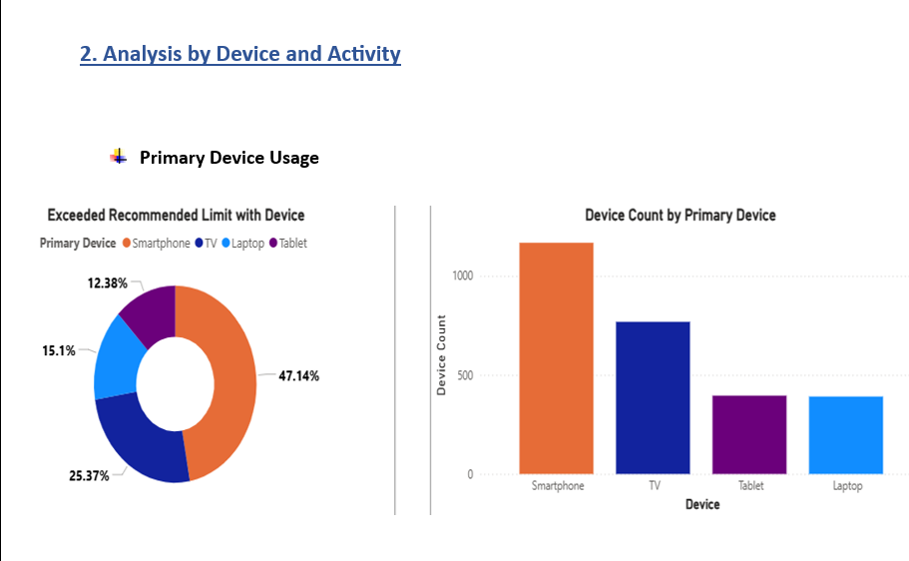
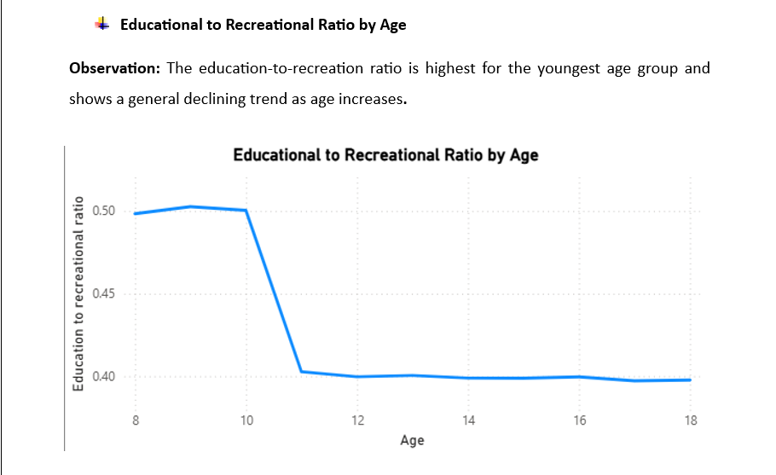
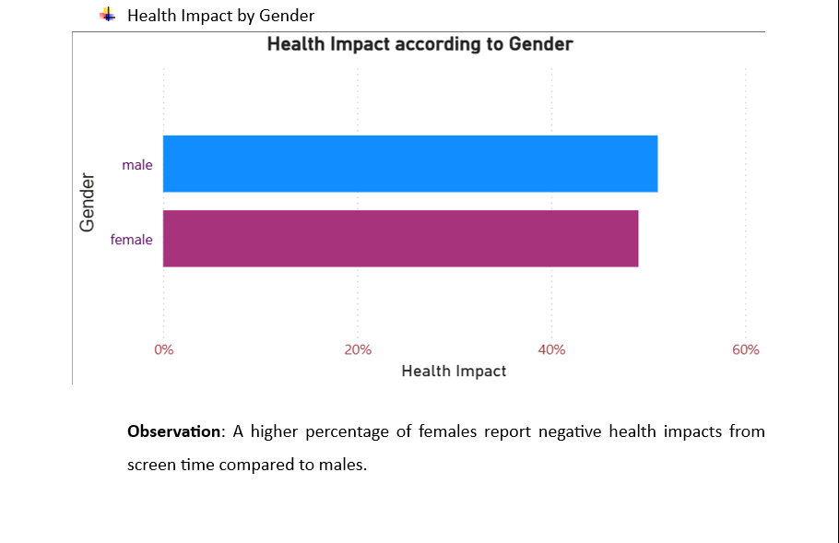
Milestone 2
Week 3: Univariate and Bivariate Visual Analysis
Week 4: Device/Activity and Weekday/Weekend Analysis

Slide 5
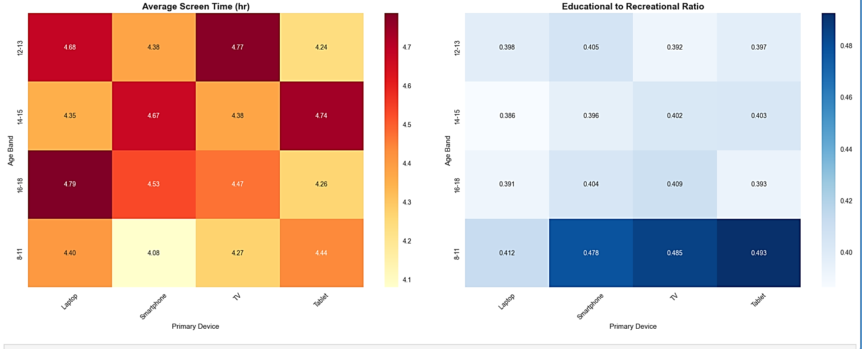
Milestone 3
Week 5: Cohort and Segment Analysis
Week 6: Seasonal/Calendar or Habit Patterns (if applicable)
Created new Columns:
Health_Impact_Count
Screen_Time_Level
Usage Type

Slide 6
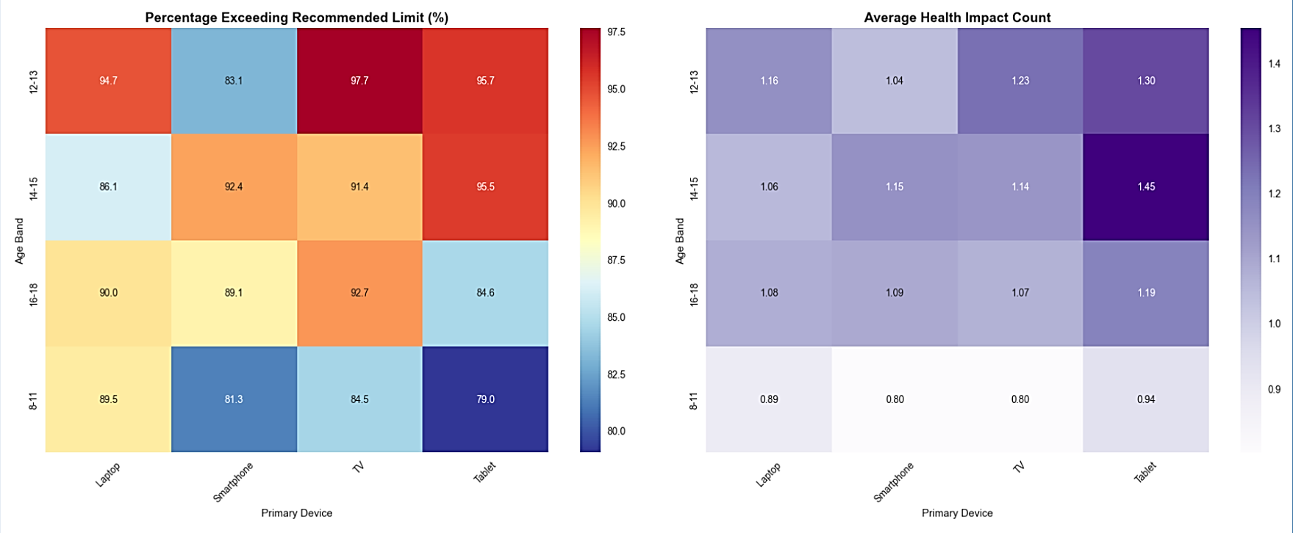
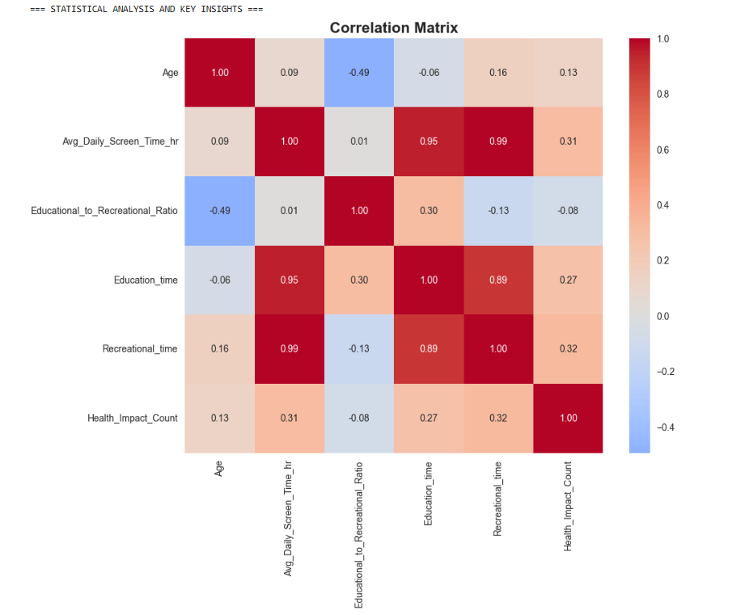

Slide 7
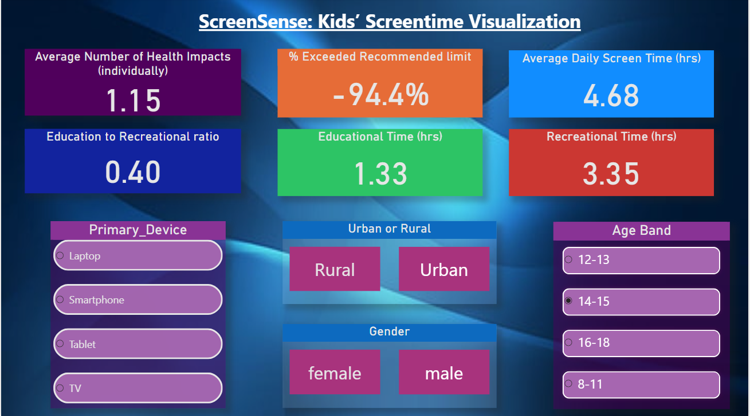
Milestone 4
Week 3: Visual Report or Dashboard Preparation
Week 4: Documentation and Final Presentation
HOME PAGE OVERVIEW
The overall KPIs help establish the baseline usage behaviour. The slicers allow users to dynamically filter the dataset and observe how screen time patterns shift across different demographic segments like gender, location, device, Age band.

Slide 8
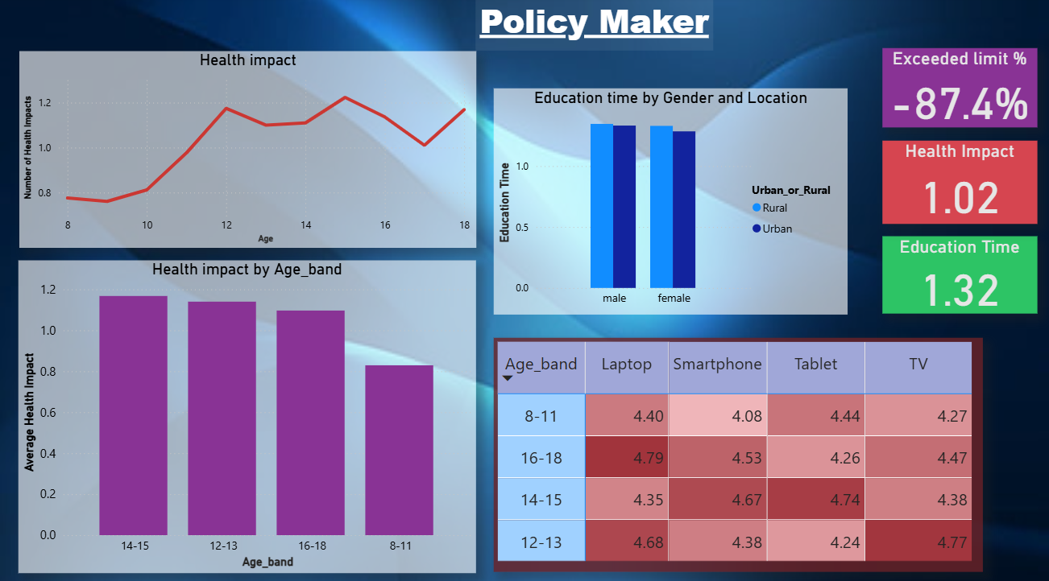
Milestone 4
POLICYMAKERS PAGE
Younger age groups tend to show higher usage of mobile devices. Health-related impacts increase with age or prolonged usage. There is very less difference (1-2%) in education time between urban and rural users, as well as between genders.

Slide 9
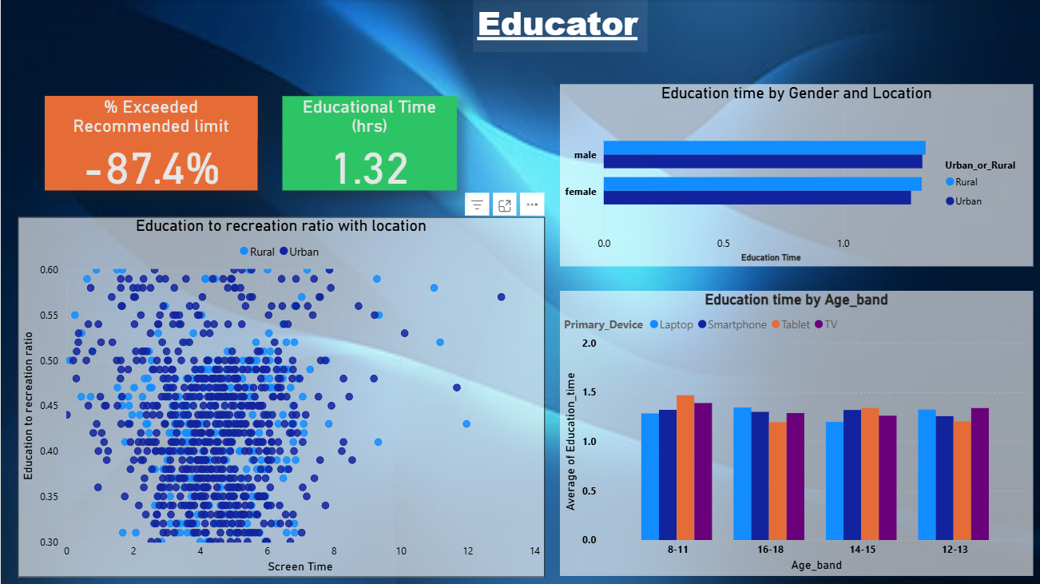
Milestone 4
EDUCATORS PAGE
The education-to-recreation ratio reveals whether time is being optimally spent.
Device dependency for education shifts significantly across age groups.

Slide 10
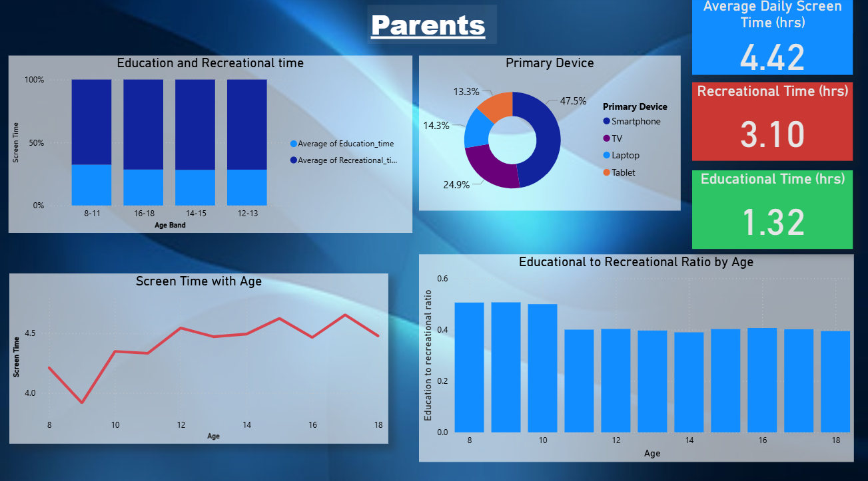
Milestone 4
PARENTS PAGE
• Parents can clearly see if children are spending excessive time on recreation compared to education. Age-based comparisons help identify critical stages where parental supervision is most needed.
• Device dependency is an important indicator of digital behaviour and potential risk levels.

Slide 11
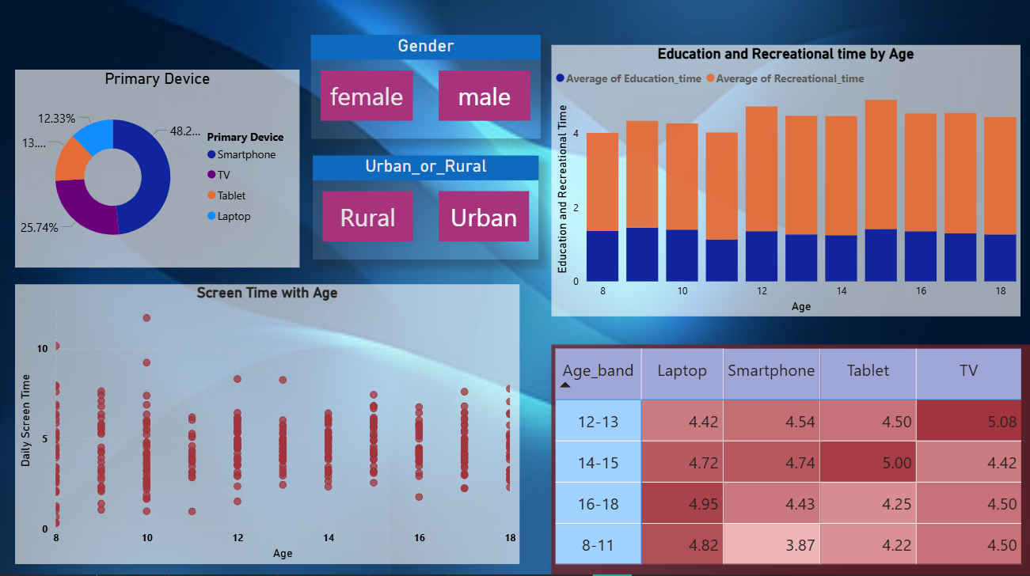
Milestone 4
Behavioral Patterns Across Key Groups
Filtering by gender or location enables deeper behavioural comparisons.
Primary device distribution indicates cohort-specific preferences.
The education–recreation ratio helps determine whether a cohort is more academically inclined or entertainment-focused.

Slide 12
Thank You!

